Slide 1

Student Performance Analysis
By - Niranjan

Slide 2
Business Problem :-
1. Identify the most important factors that affect student performance.
2. Provide a data – driven strategy to enhance academic outcomes.
3. Develop visualization and summary statistics to communicate findings effectively.
4. Analyse the distribution of key variables and detect any correlation between them.

Slide 3
Data Source – The board has collected a range of data from various sauces, including demographic Information, study habits, school attendance, parental involvement and students academic Records.
Number of Rows – 6607
Number of Columns - 20
This data sets includes :
Hours Studies, Attendance, Parental Involvement, Access to Resources,
Extracurricular Activities, Sleep Hours, Previous Scores, Motivation Level,
Internet Access, Tutorial Sessions, Family Income, Teacher Quality, School Type,
Peer Influence, Physical Activity, Learning Disabilities, Parental Education Level,
Distance from home, Gender, Exam Score.

Slide 4
Missing value & Solutions: -
Teacher Quality was missing 78 missing values, resolved with Mode
Parental Education Level was missing 90 missing values, resolved with Mode.
Distance from home was missing 67 values, resolved with Mode
Categorical Variables: -
Family Income
Distance from home
Parental Involvement
Access to Resources
Extracurricular Activities
Motivation Level
Internet Access
Teacher quality
School Type
Peer Influence
Learning Disabilities
Parental Education Level
Gender

Slide 5
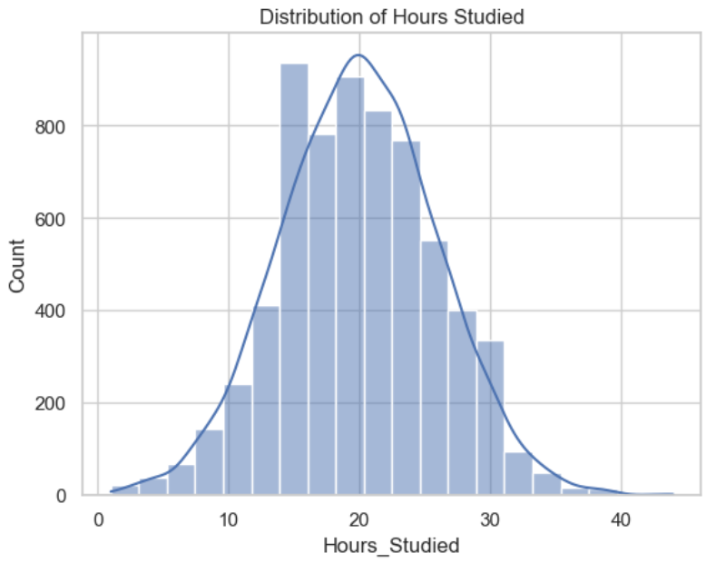
Univariate Analysis: -
Hours Studied
Most student study for 15-20 hrs.
Slightly right skewed (means few students study more than 30 hr)
Few student study less then 10 hrs.

Slide 6
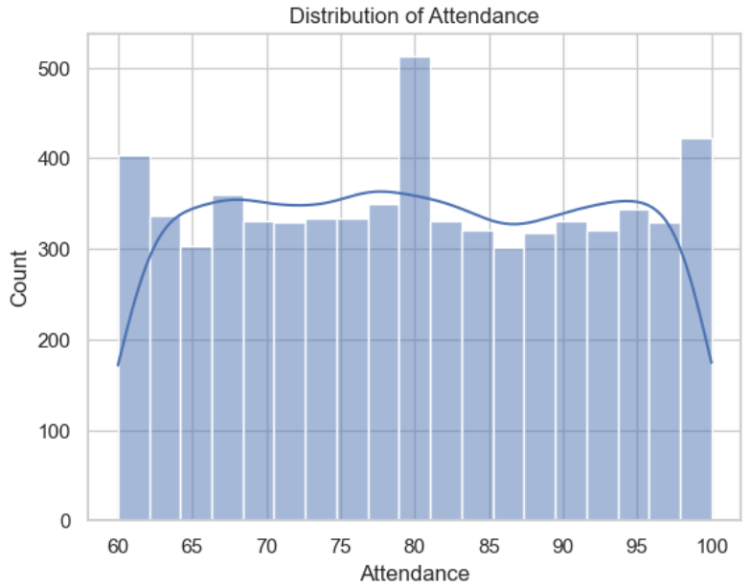
2. Attendance
Maximum students were present for 80 days
Minimum student were present for 65 days.
Students having low attendance was quite high.

Slide 7
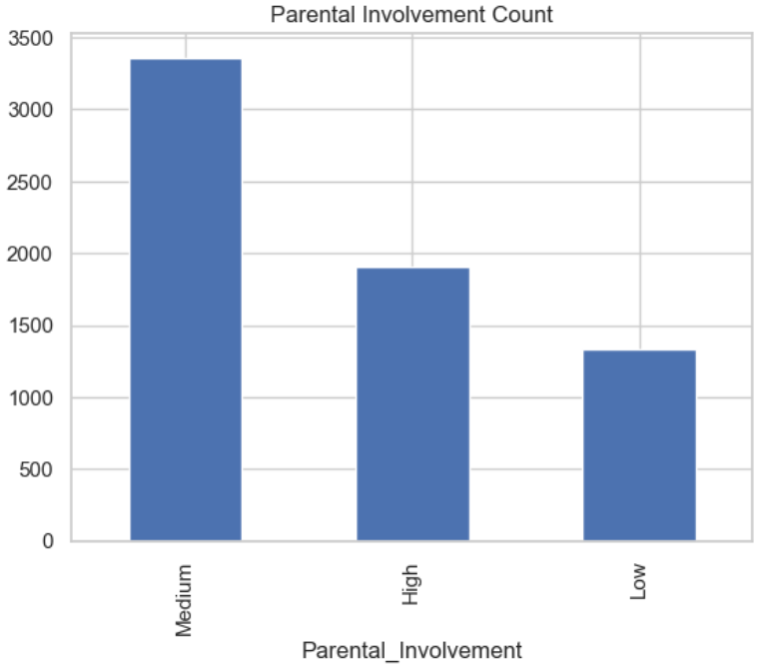
3. Parental Involvement
Parents were moderately involved in their studies
Few parents were least involved with the students.

Slide 8
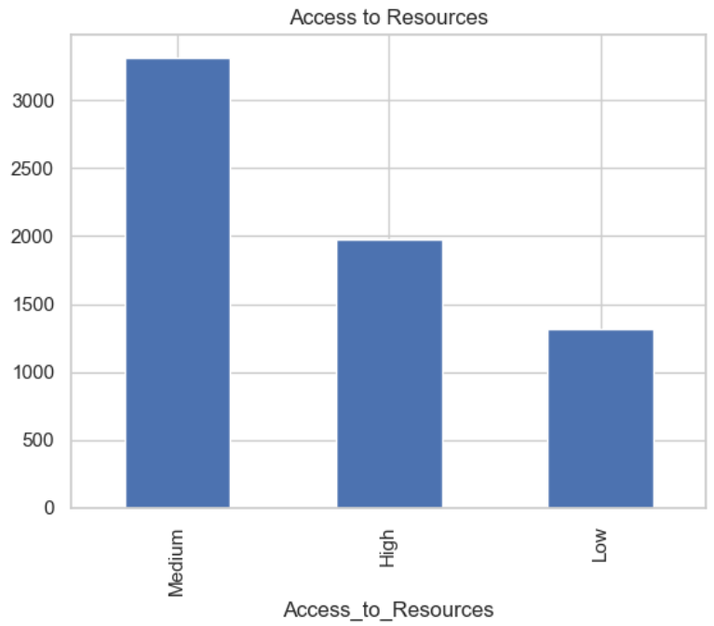
4. Access to resources.
Students are having moderate study resources.
Almost half of the students were having access to the resources .

Slide 9
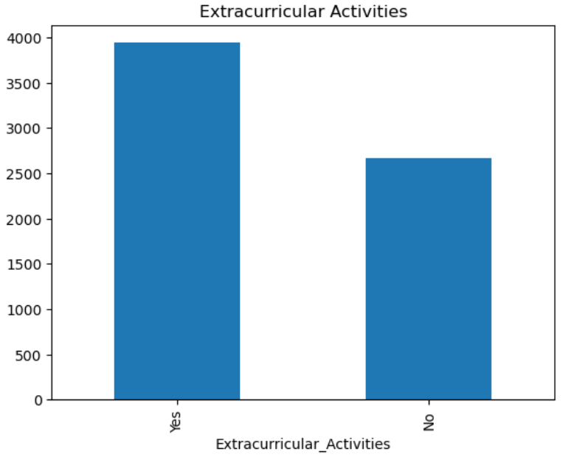
5. Extracurricular Activities
Students involved in Extracurriculr Activities was quite high (3938 /6607) .

Slide 10
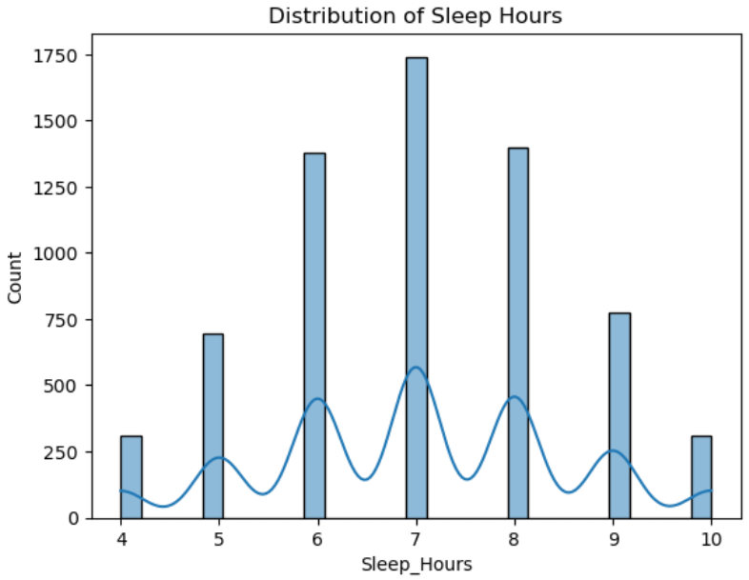
6. Sleep Hours
Students having 7 hours of sleep was quite high.
Few student sleep less than 4 hrs, while few sleep more than 10 hrs.

Slide 11
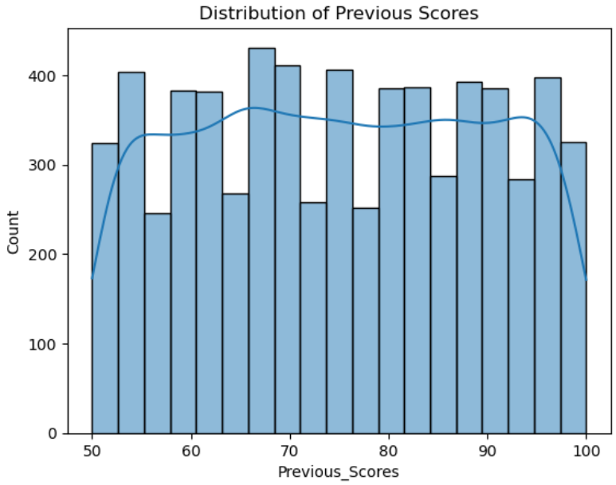
7. Previous Scores
More students(165) score near 66 in their previous scores.
While top rankers were (69)
Students with minimum score were (62)

Slide 12

8. Motivation Level
Majority of the students were motivated on a medium level (3351)
Students with low motivation level were (1937)
Motivated students were (1319)

Slide 13
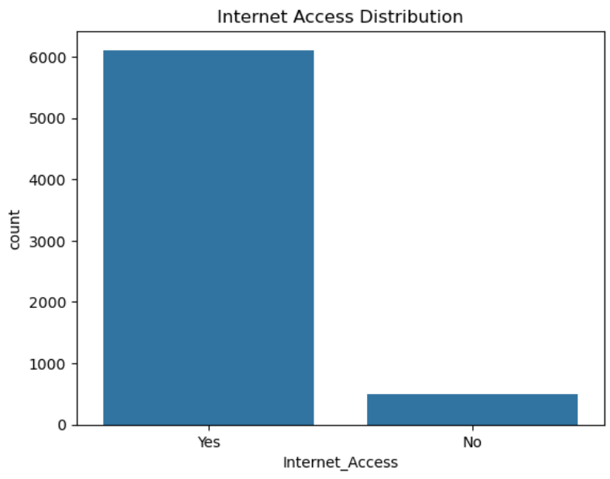
9. Internet Access.
Majority students were having access to internet.(1608)
Vert few have no access to internet (499)

Slide 14
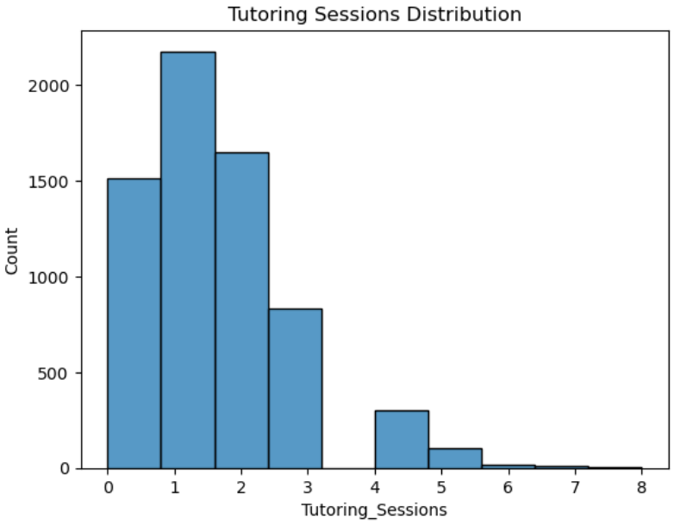
10. Tutoring Sessions.
Majority of the student have 1 tutoring session (2179)
Student with no tutoring session was quite high (1513)
Few students have 6-8 tutoring session

Slide 15
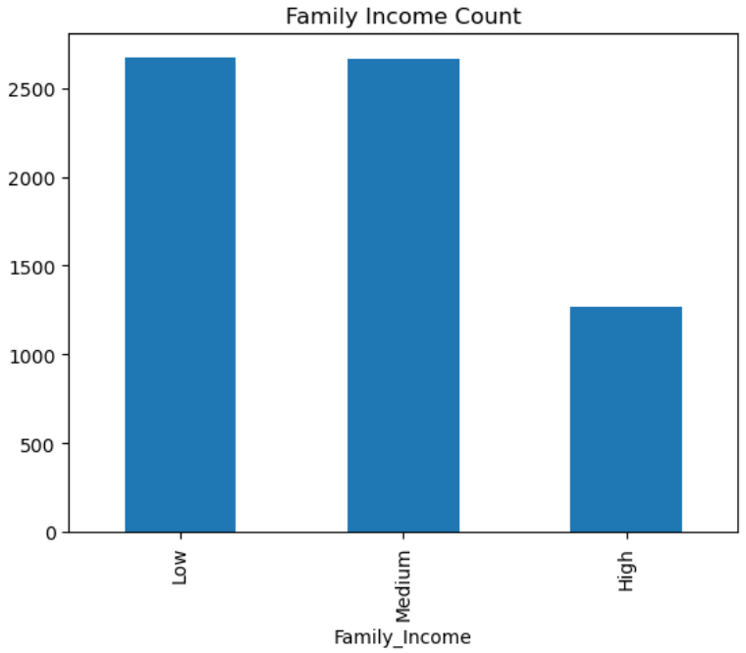
11. Family Income.
Majority of students belongs to family with low income (2672) & family with medium income(2666).
Few students comes from family with high incomes(1269).

Slide 16
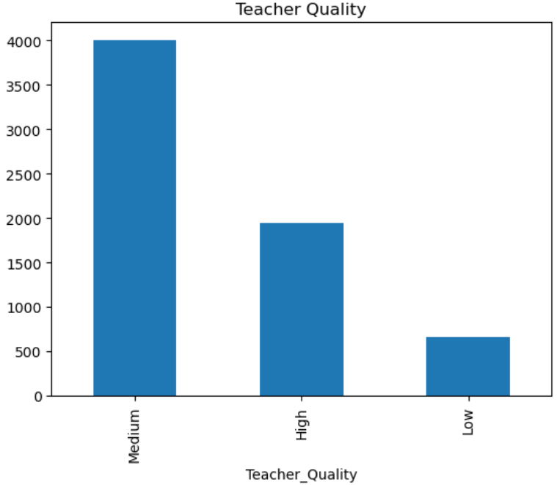
12. Teacher Quality.
Majority of the schools have mid level teacher (3925).
Low teacher quality in the school was (657)

Slide 17
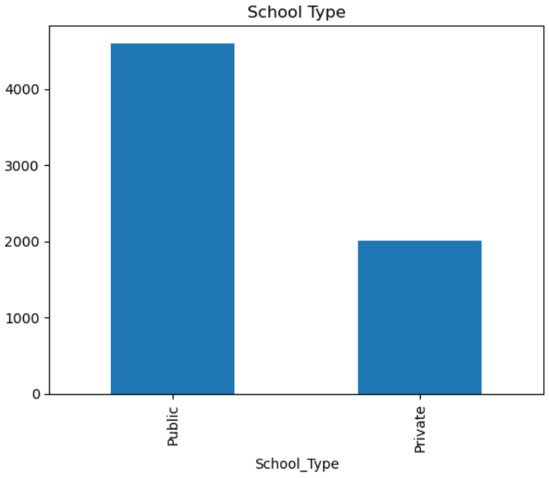
13. School Type
Majority of the schools are Public Schools (4598).
Private Sector Schools were (2009).

Slide 18
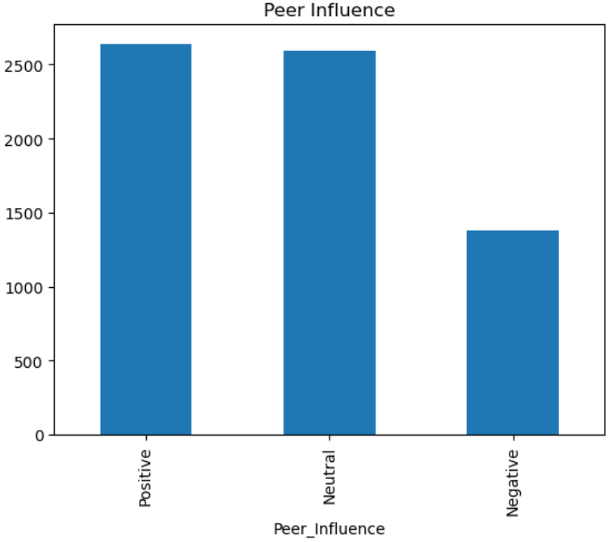
14. Peer Influence
Majority of the students were under positive peer influence (2638) and medium peer influence (2592).
Few students were under negative peer influence (1377).

Slide 19
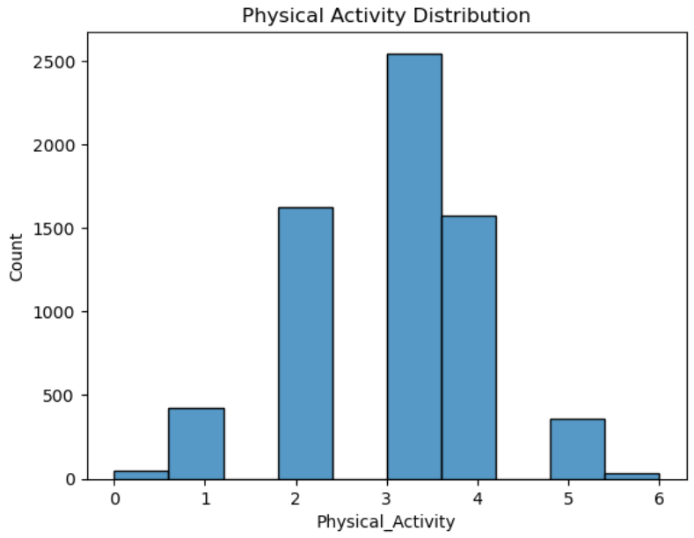
15. Physical Activities
Majority of the students have 3 physical activities(2547).
Students with no physical activities(46).
Students with 6 physical activities (32).

Slide 20
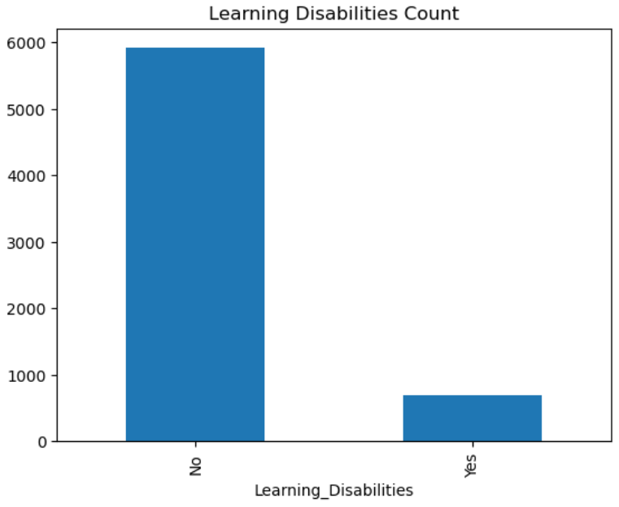
16. Learning Disabilities.
Student with learning disabilities (695).

Slide 21
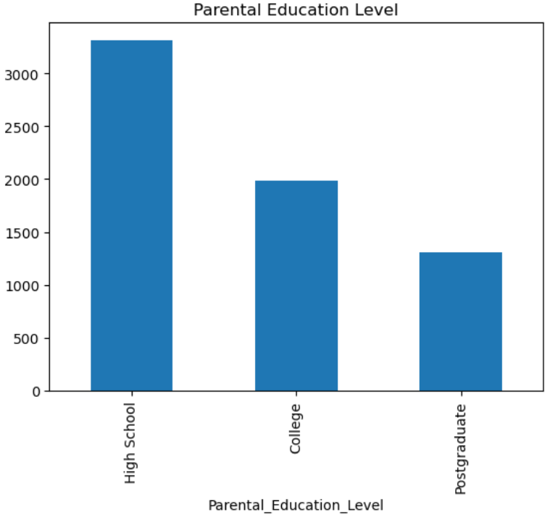
17. Parental Education Level.
Majority of the parents have completed their high schools(3223).
Parents who completed their college (1989).
Parents who were from postgraduates(1305).

Slide 22
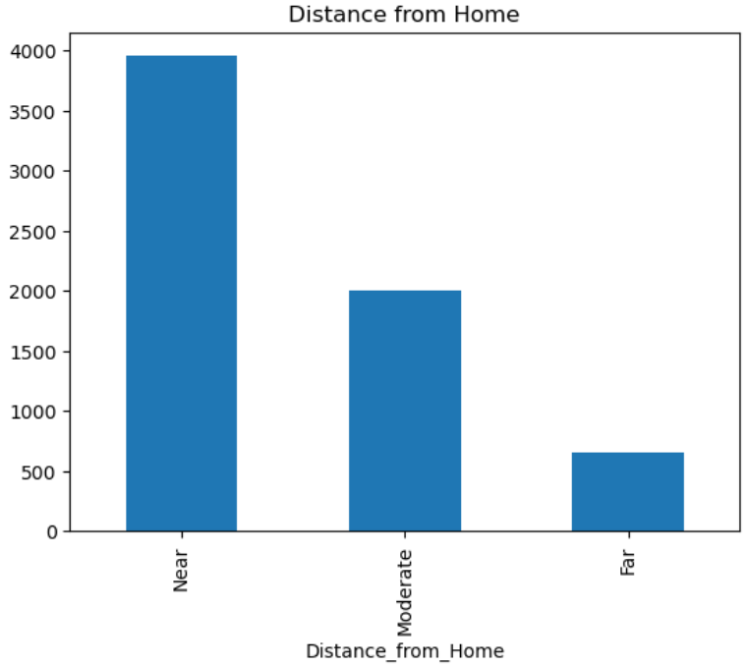
18. Distance from home.
Majority of the students leave nearby (3884).
Few students live far away (658).

Slide 23
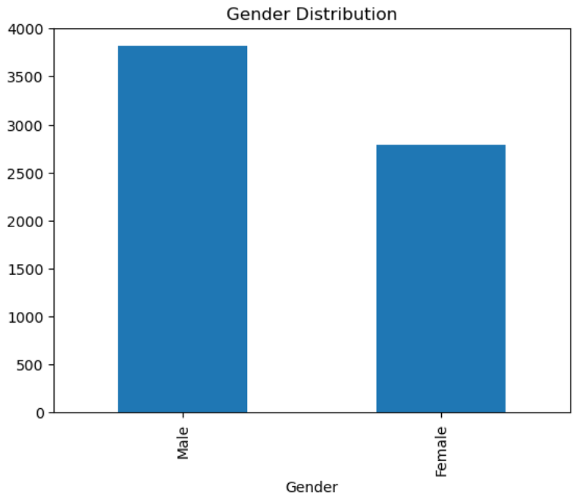
19. Distance from home.
Male Students – 3814
Female Students - 2793

Slide 24
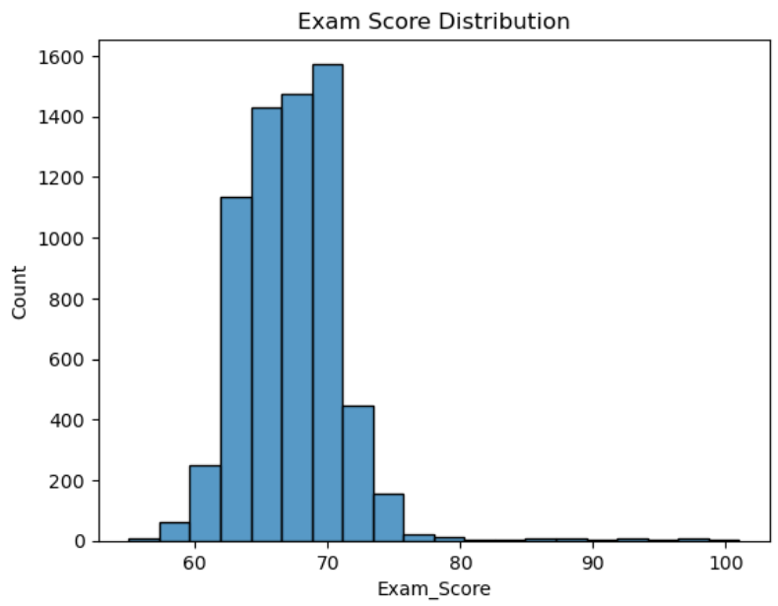
20. Exam score.
Most of the student scored 66 marks (579 students)
Only 1 student scored 100.
There was a data entry mistake (101 marks)

Slide 25
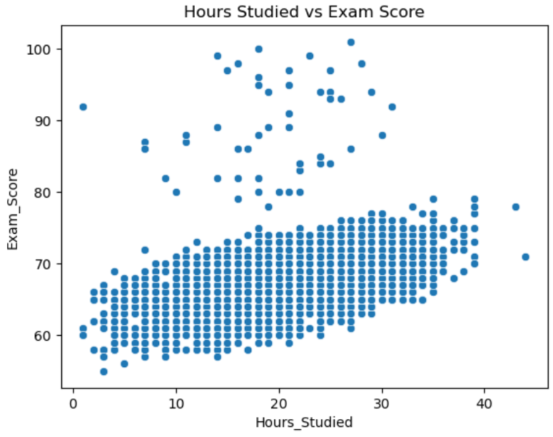
Bivariate Analysis: -
Relationship between Hours studied and Exam Score.
As hours studied increase the exam score also increases.
Student wo study for 25-30 hrs observed to score more marks.
Few Students have score more even with low study hours and some score less with high studying hours.
Most student scored 60-75 with 10-30 hrs of studying.

Slide 26
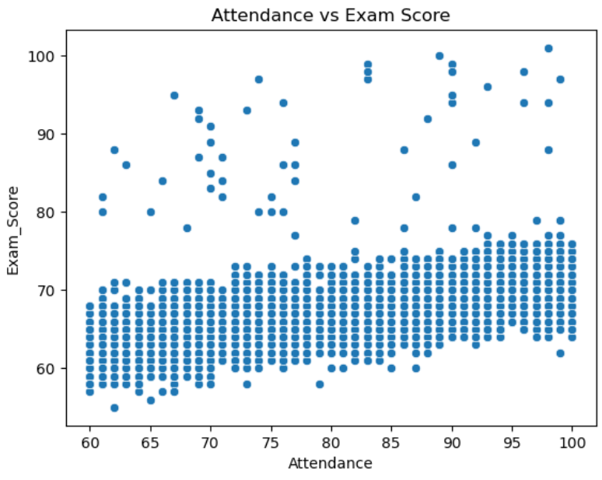
2. Relationship btw Attendance and Exam Score.
As Attendance increases Exam score also increases.
Students wo have full attendance tends to have more marks.
Some students have low attendance and moderate scores.
Most student score 60-75 with 70-100 attendance.

Slide 27
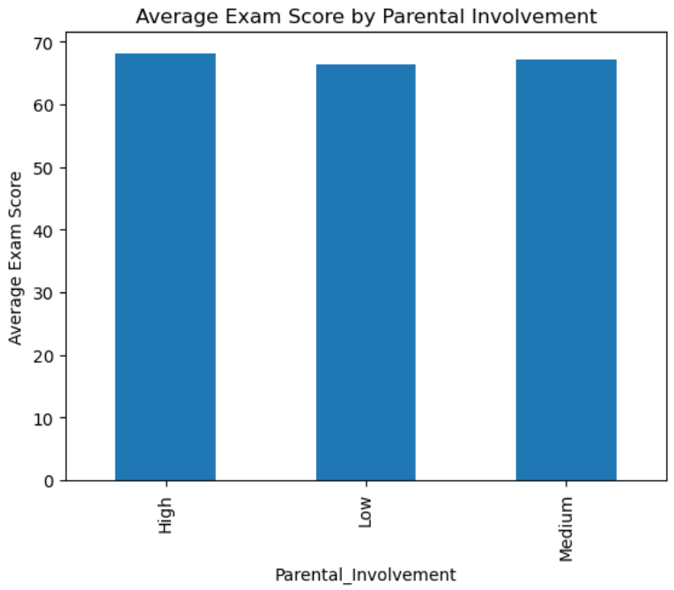
3. Relationship btw Parental Invovement and Exam Score.
Parental involvement has no as such significant impact on the average exam scores.
A slight increase in the marks when the parental involvement was high as compared to low parental involvement.

Slide 28
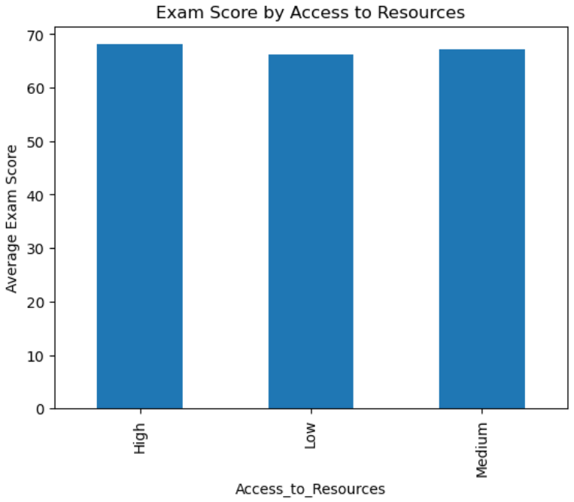
4. Relationship btw Acess to resource and Exam Score.
High access to resource has no as such significant impact on the average exam scores.
A slight increase in the marks when the access to resource was high and medium as compared to low access to resources.

Slide 29
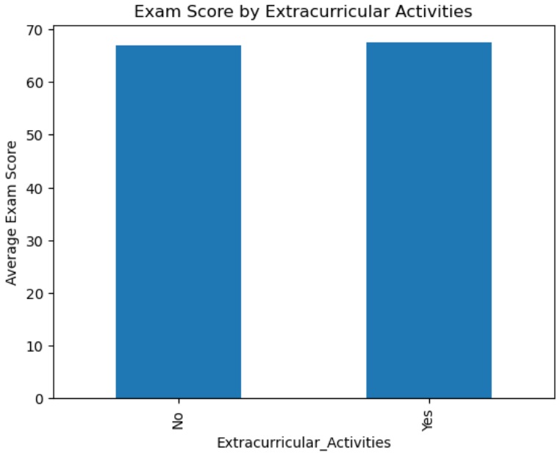
5. Relationship btw Acess to resource and Exam Score.
Extracurricular does not have any impact on the Average exam score.

Slide 30
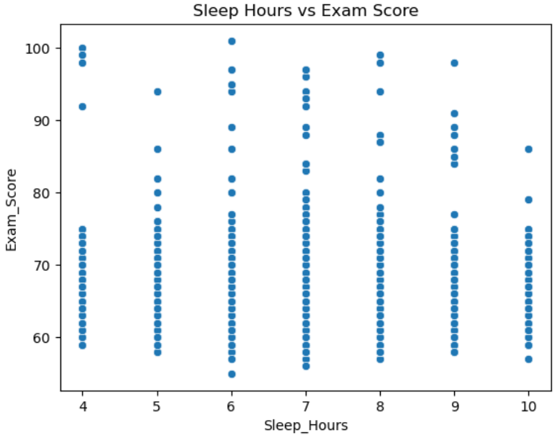
6. Relationship btw Sleep Hours and Exam Score.
It dosn’t show a upward or downward trend.
Student wo have 6 hrs of sleep have shown a significant increase in the score.
Some students who sleep less (less than 4 hrs) also have a good score.
Students who sleep more score less.
Students who sleep 5-10 hrs usually have score btw 60-75 .

Slide 31
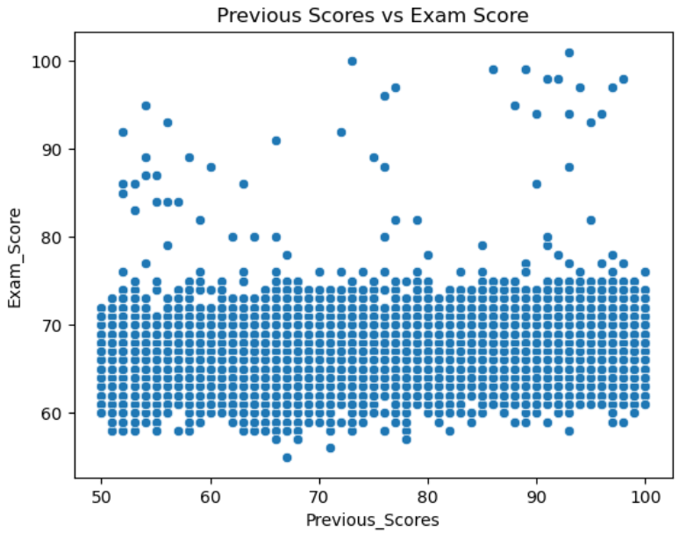
7. Relationship btw Previous score and Exam Score.
It doesn't show a upward or downward trend.
Exam score remained btw 60-75 regardless of the previous score.
Some students who score less in the previous test tends to score high and vide versa.
There is no such important relation for Previous score and exam score.

Slide 32

8. Relationship btw Motivation level and Exam Score.
There is no such important relation for Motivation level and Average Exam Score.

Slide 33
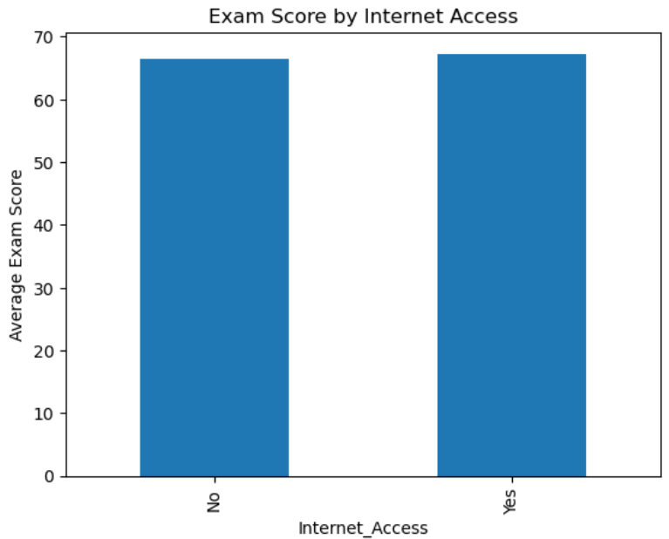
9. Relationship btw Internet Access and Exam Score.
There is no such important relation for Internet Access and Average Exam Score.

Slide 34
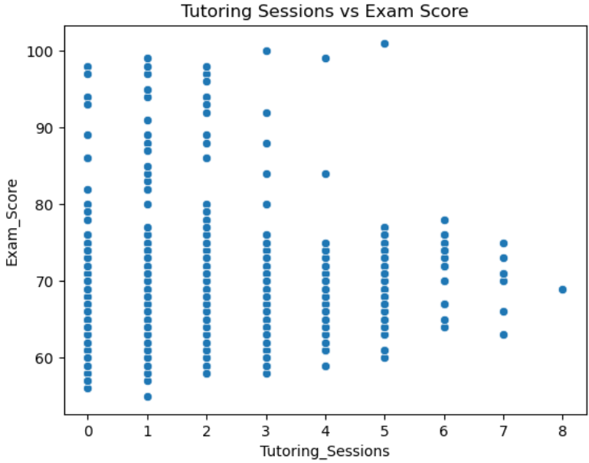
10. Relationship btw Internet Access and Exam Score.
Many student with 0-2 sessions scored quite high, while those with more sessions(5-8) didn’t necessarily perform better.
For each number of tutoring sessions, score are spread widely from 50-100
The higher no of sessions, the lower the scores.
Reverse trend.

Slide 35

11. Relationship btw Family Income and Exam Score.
There is no such important relation for Family Income and Average Exam Score.

Slide 36
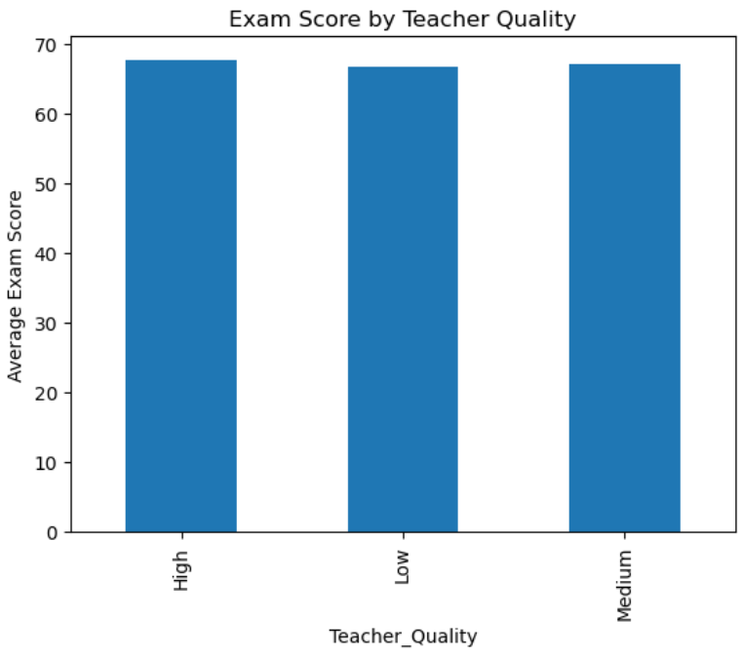
12. Relationship btw Teacher Quality and Exam Score.
There is no such important relation for Teacher Quality and Average Exam Score.

Slide 37
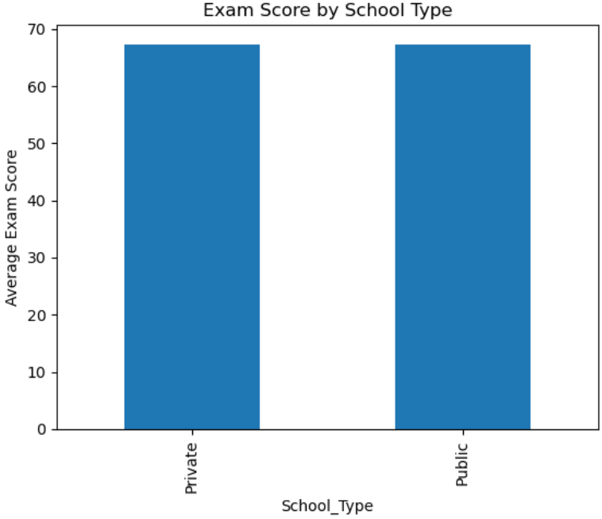
13. Relationship btw School Type and Exam Score.
There is no such important relation for School Type and Average Exam Score.

Slide 38
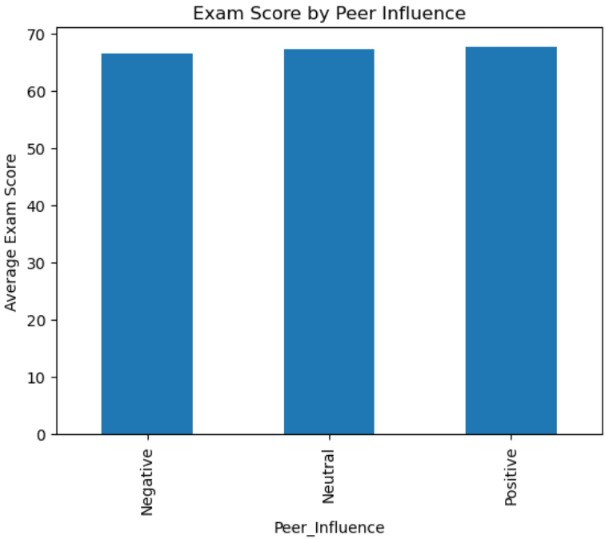
14. Relationship btw Peer Influence and Exam Score.
There is no such important relation for Peer Influence and Average Exam Score.

Slide 39
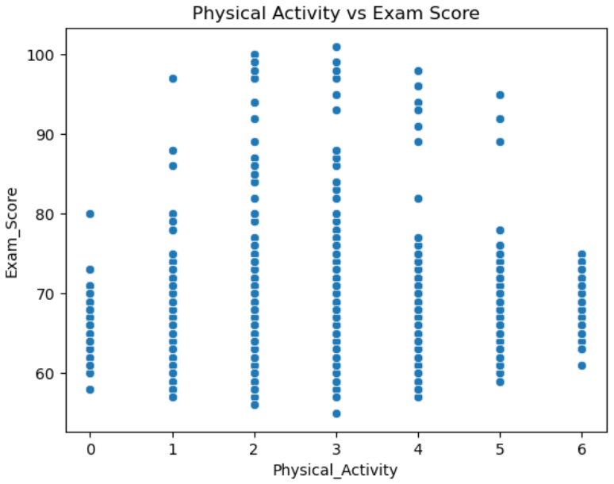
15. Relationship btw Physical Activity and Exam Score.
Students with both low and high physical activity levels achieved a wide range of scores.
High scores (above 90) are present across all levels of activity.
The score is consistently spread btw 60 and 100 regardless of the physical activity value.

Slide 40
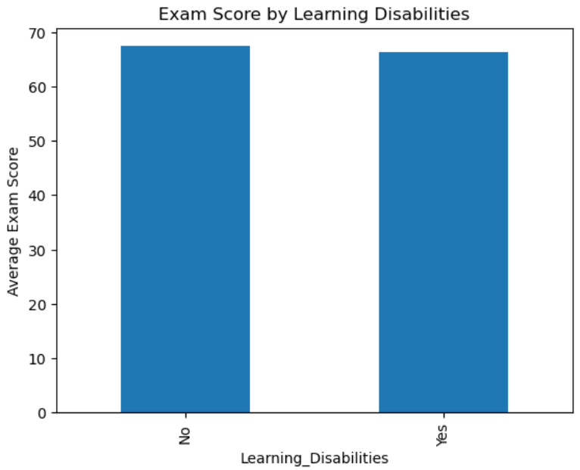
16. Relationship btw Learning Disabilities and Exam Score.
There is no such important relation for Learning Disabilities and Average Exam Score.

Slide 41
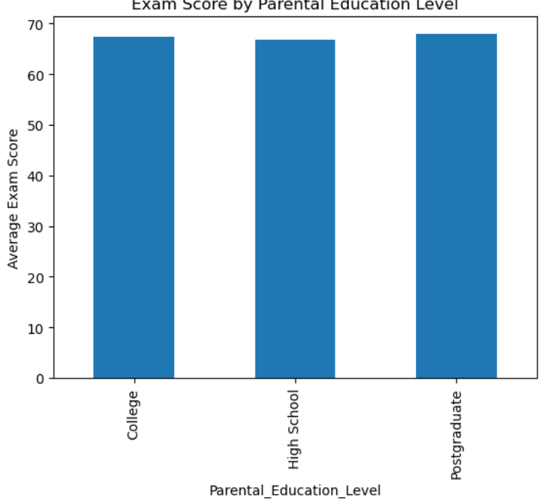
17. Relationship btw Parental Education level and Exam Score.
There is no such important relation for Parental Education Level and Average Exam Score.

Slide 42
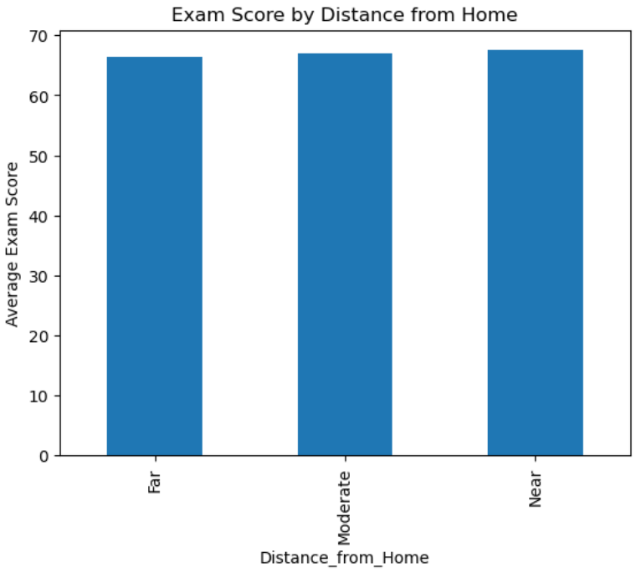
18. Relationship btw Distance from home and Exam Score.
There is no such important relation for Distance from home and Average Exam Score.

Slide 43

19. Relationship btw Gender and Exam Score.
For both the genders the average exam score was quite high.

Slide 44
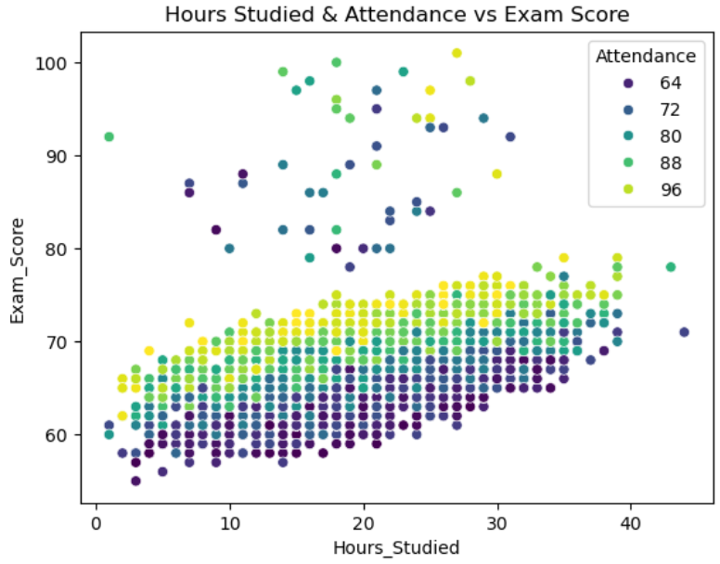
Multivariate Analysis: -
Hours Studied & Attendence Vs Exam Score.
Students who studied more and had higher attendance(light colour dots) tends to score higher.
At similar levels of study hours, students with higher attendance often performed better than those with lower attendance.
Regular attendance and studing regularly contribute to better performance.

Slide 45
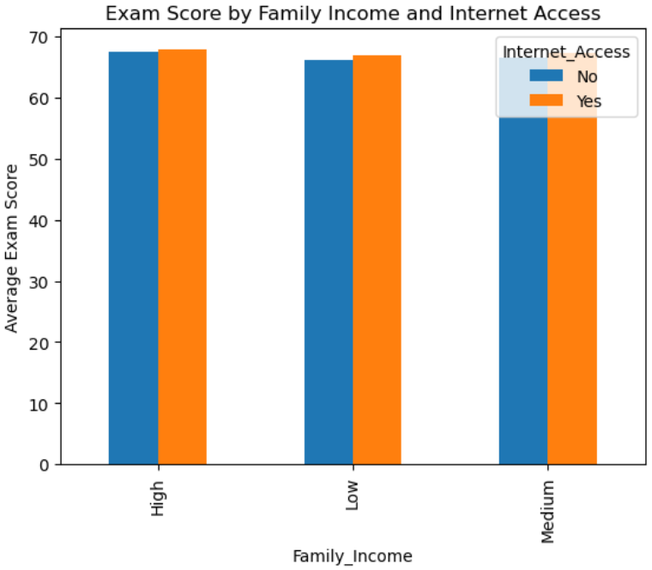
2. Exam Score by Family income and Internet access.
Students from all income levels(High, Medium, Low) show slightly higher average exam scores when they have Internet access.
The Difference is small but consistent, suggesting internet access may provide a slightly academic advantage.
Income level itself does not show a large impact on average exam score.

Slide 46
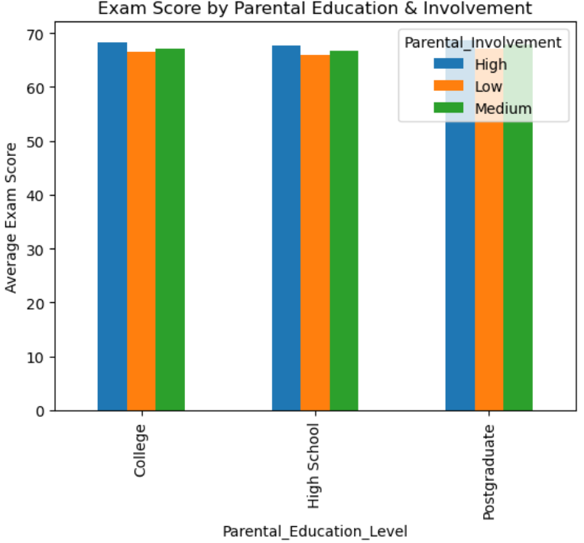
3. Exam Score by Parental Education & Involvement.
Across all parental education levels(High School, College,Postgraduate) student with high parental involvement tends to have slightly better average exam scores .
The Parental Education level itself does not show a strong influence on exam scores .
The Parental involvement level appears to have consistent on student performance.

Slide 47
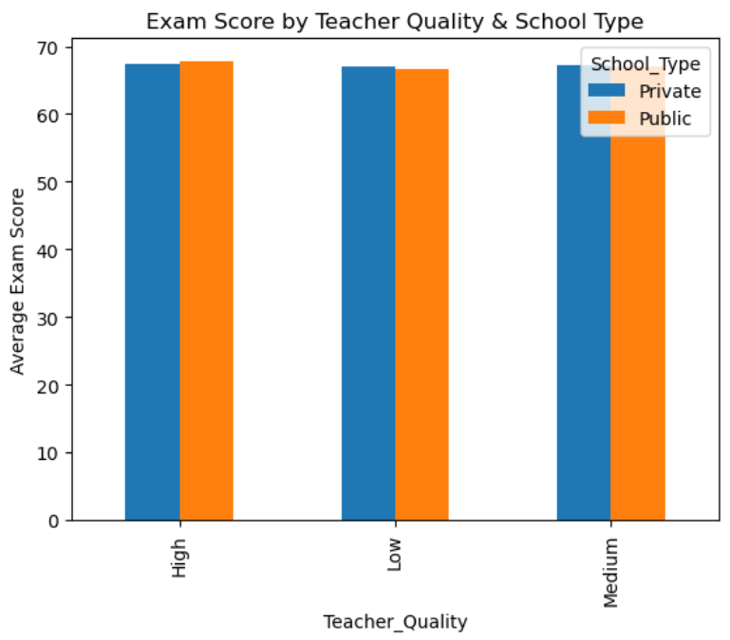
3. Exam Score by Teacher quality and School type.
The average exam scores are quite similar across all levels of teacher quality.
There is no significant difference in exam scores between Private and Public schools for any level of teacher quality.
Both Teacher quality and school type may not be strong predictors of exam performance.

Slide 48
4. Exam Score by Motivation, Tutoring Sessions & Peer influence.
Within each subplots there is a general trend that higher Motivation level is associated with higher average exam score. This is true across different levels of peer Influence and Tutoring sessions where data is available.
Scores for High Motivation are generally higher than medium which is generally higher than low.
Positive peer influence (blue bars) is associated with the highest exam scores.
Negative peer influence (orange bars) is associated with the lowest average exam scores.
Neutral peer influence(green bars) results in average scores typically between those of positive and negative influence.
Increase in tutor session result in increase in average exam scores.

Slide 49
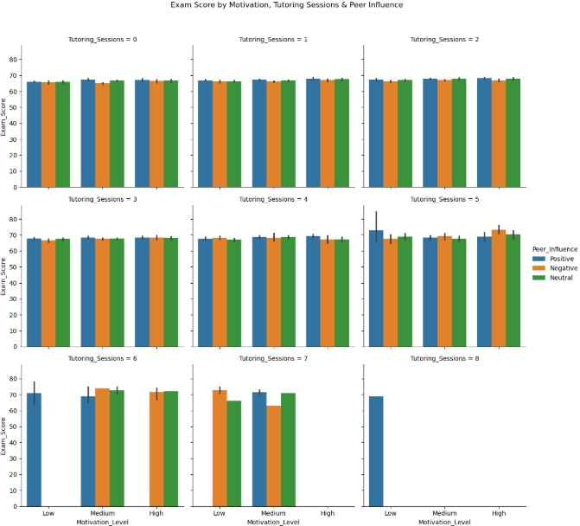

Slide 50
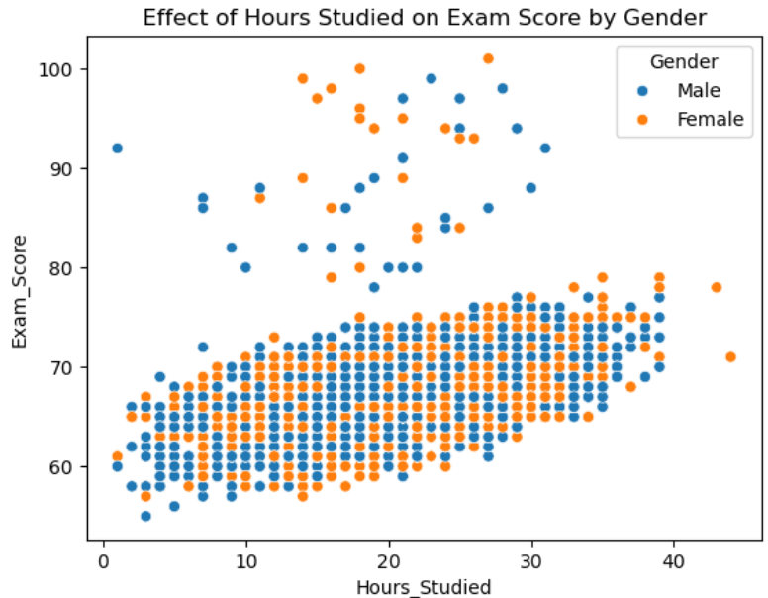
5. Effect of Hours studied on Exam Score by gender.
As hours increased exam score generally tends to increase for goth genders.
Both male and female follow a similar upward tend .
Few Students from both the gender have scored exceptionally high.
Most scores seems clustered around 60 -80 marks range with gradual rise in studying hours.

Slide 51
6. Exam scores by sleep, Physical Activitiy & Disabilities.
Most Exam scores fall within 60-80 across all sleep Hours, Physical Activity levels and Learning Disabilities categories.
Student without learning disabilities consistently score slightly higher than those with Learning Disabilities.
Higher sleephours tends to associate with higher average exam scores.
Positive Lift in performance at 9 and 10 hrs compared to lower sleep durations.
Physical Activvity don’t show any consistent effect on the exam scores.
9-10 hrs of sleep and moderate physical activities(around 3-4) seems to associate with the highest scores.

Slide 52
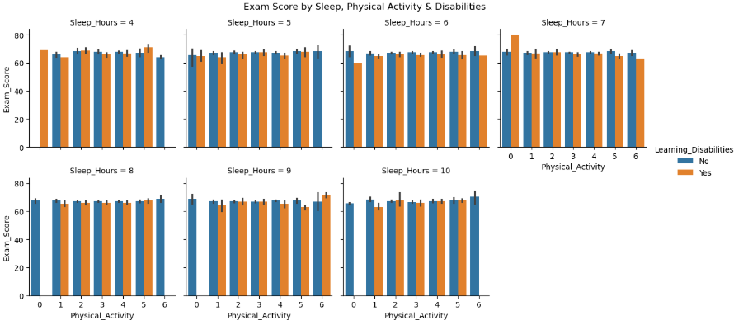

Slide 53
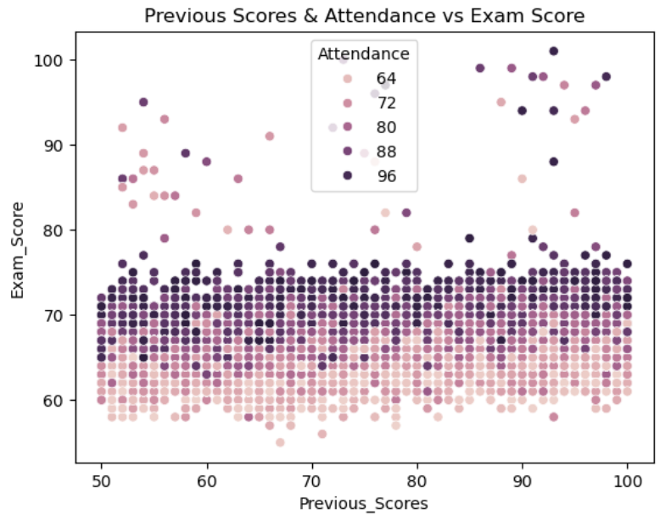
7. Previous scores & Attendence Vs Exam Score.
Previous Scores and Exam Scores shows a moderate positive correlation – higher previous scores tends to associate with higher exam scores.
Darker dots (higher attendance) are mostly found in the higher score regions for both Previous Scores and Exam Scores.
Majority of students, regardless of attendance, score between 60-80
Students with attendance 88-96(dark purple dots) shows a visible tendency to cluster at the upper exam score range, even if their previous scores wasn’t the highest.

Slide 54
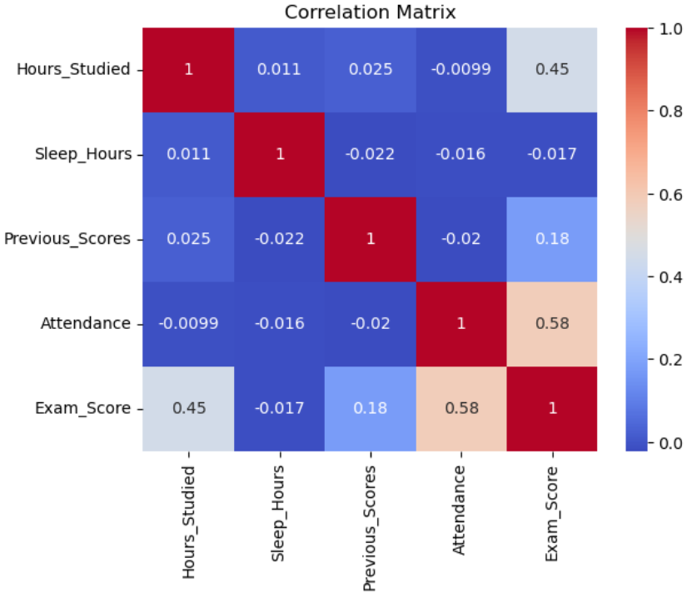
7. Previous scores & Attendence Vs Exam Score.
Attendance (0.58) -> Strong positive corelation
Hours Studied (0.45) -> second highest positive corelation.
Previous Score(0.18) -> Weak positive corelation.
Sleep hours (-0.017) -> essentially no correlation with Exam Score.
Other variable pair correlations are also weak/negligible.

